Slide 1

THOUGHTBUBBLE
Concept​/​UI​ ​Exploration | Low-Fidelity​ ​Prototype​ | Usability Testing

Slide 2



TEAM MEMBERS
Po Tsui
Bonnie Nortz
Jenny Kim
Grace Hong

Slide 3

ROADMAP:
Key points for feedback
Value proposition
Selected interface
Prototype structure
Tasks
Experimental method
Results
Suggested UI changed

Slide 4
KEY POINTS FOR FEEDBACK
What can be pared down
Clearly identify actionable elements
User flow

Slide 5
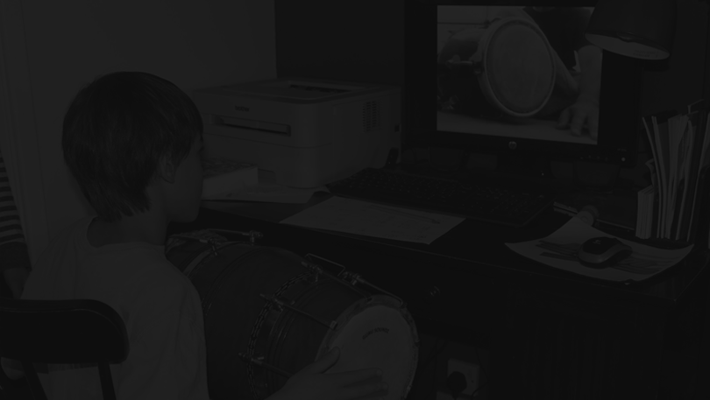
GET HELP TALKING
ABOUT THE TOUGH QUESTIONS. EXPAND YOUR BUBBLE
VALUE PROPOSITION

Slide 6
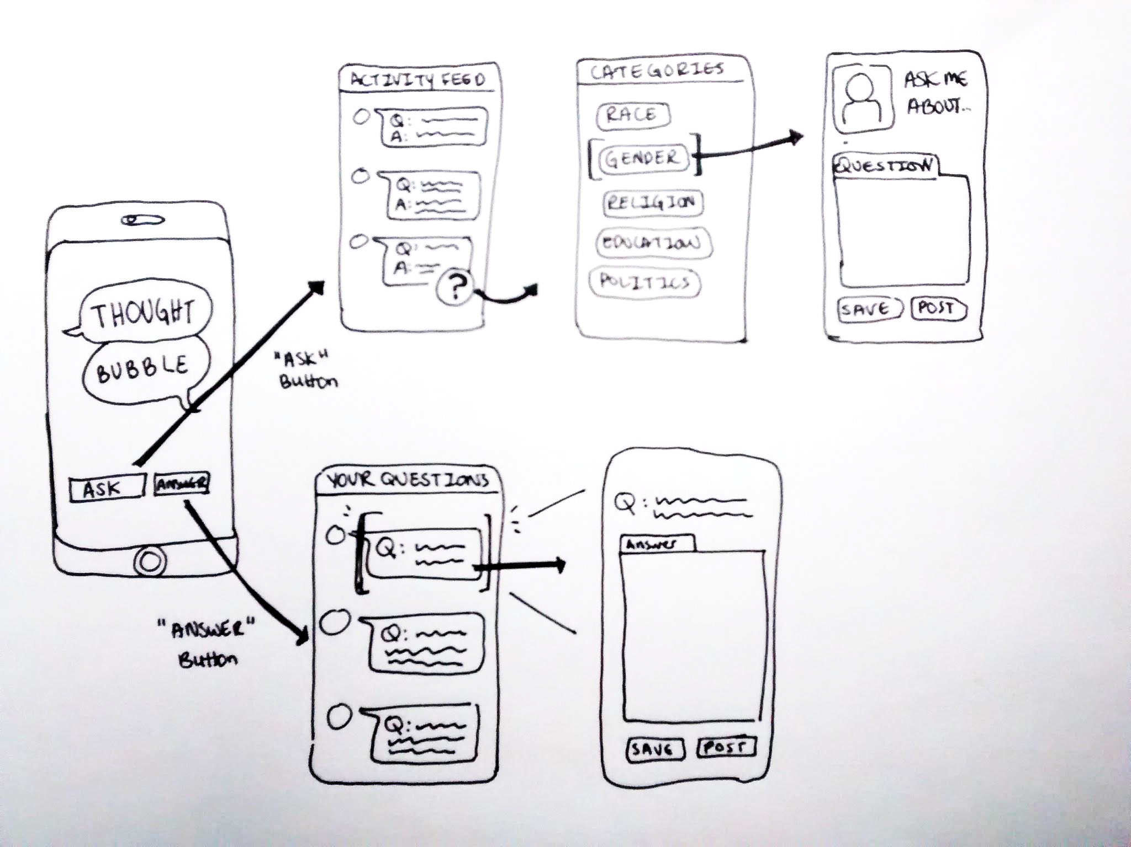
SELECTED INTERFACE: MOBILE
transform the flow and content of conversation
incorporate into regular routine and normal devices
translate into real life conversations

Slide 7
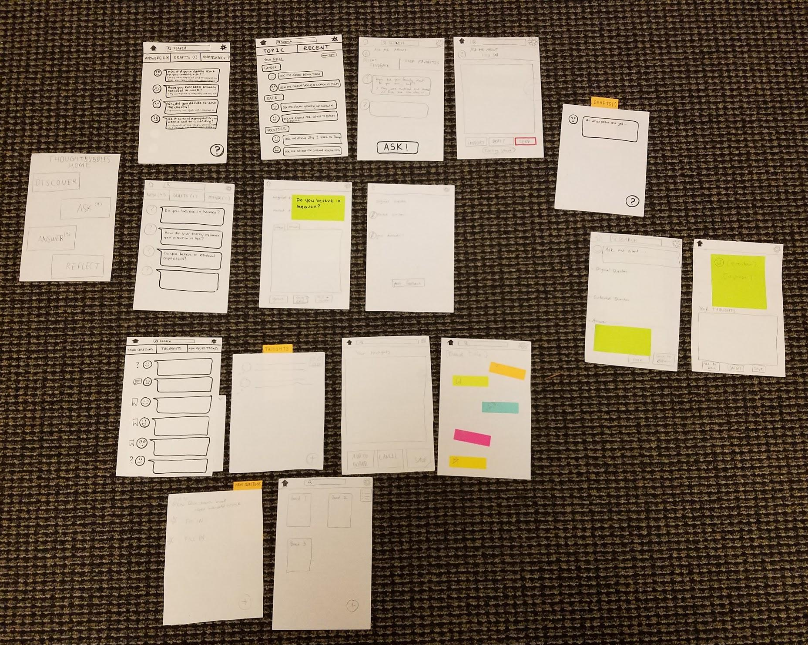
LOW-FI PROTOTYPE STRUCTURE
ASK
ANSWER/
CRITIQUE
REFLECT

Slide 8
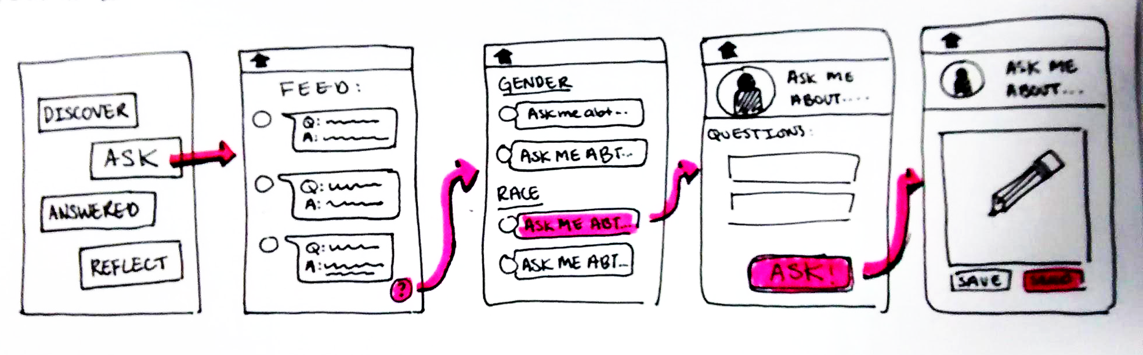
TASK 1 | ASK AN ANONYMOUS QUESTION (MODERATE)

Slide 9
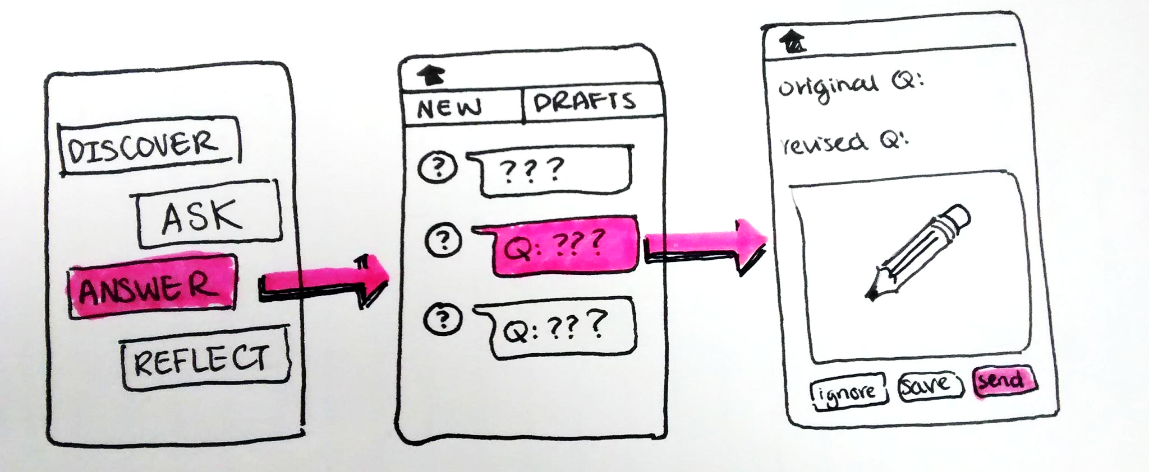
TASK 2 | ANSWER/CRITIQUE A QUESTION (SIMPLE)

Slide 10
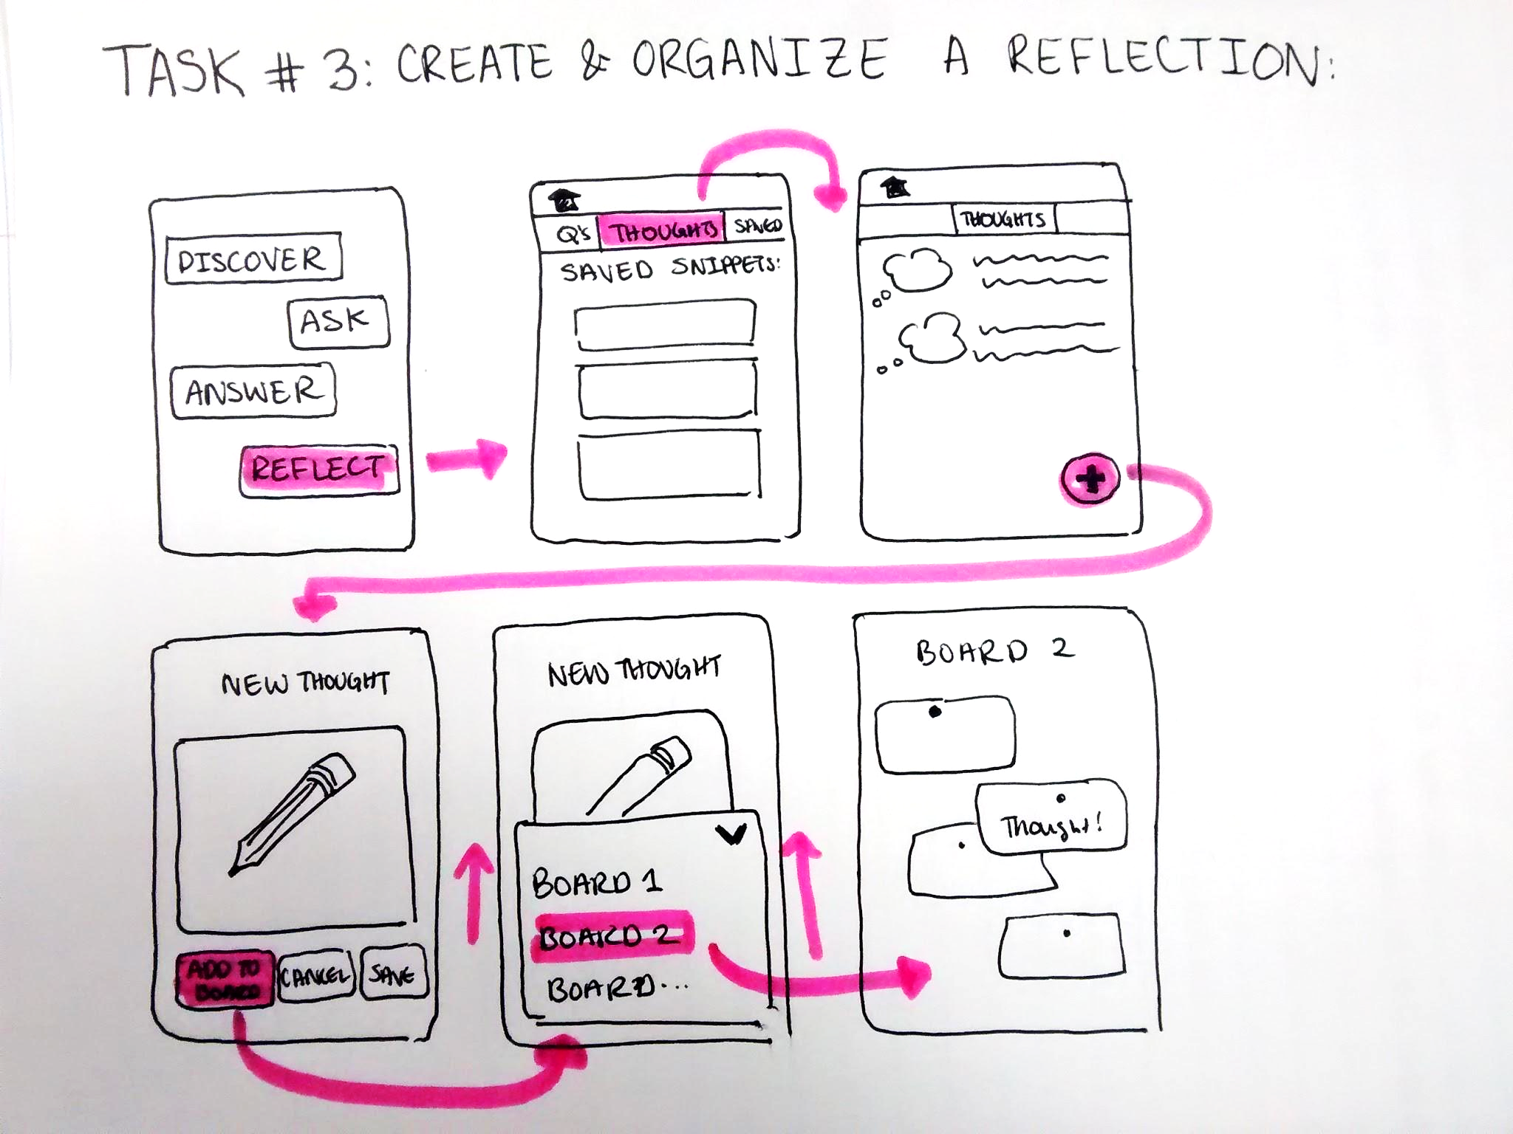
TASK 3 | REFLECT ON WHAT YOU LEARNED (COMPLEX)

Slide 11

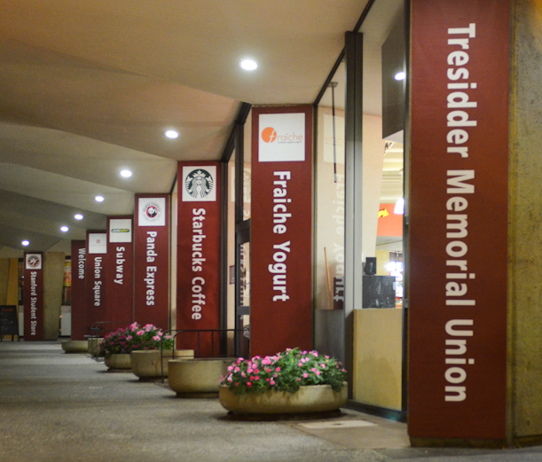
EXPERIMENTAL METHOD
Time
Number of tries
Emotion
Hot spots
SETUP
PROCEDURE
METRICS

Slide 12
EXPERIMENTAL RESULTS
Navigation issues

Slide 13
EXPERIMENTAL RESULTS
Navigation issues

Slide 14
EXPERIMENTAL RESULTS
Navigation issues

Slide 15
EXPERIMENTAL RESULTS
Navigation issues

Slide 16
EXPERIMENTAL RESULTS
Distracting content

Slide 17
EXPERIMENTAL RESULTS
No critique

Slide 18
SUGGESTED UI CHANGES
simplify number of screens
streamline functionality
more prominent and persistent navigation

Slide 19
SUGGESTED UI CHANGES
Make “critique” and “answer” separate screens
Address the issues of anonymity and safety

Slide 20
CONCLUSION
Three diverse test users
Navigation issues
Completed tasks with ease once on the right page
Simplify and streamline

Slide 21
CONCLUSION
Three diverse test users
Navigation issues
Completed tasks with ease once on the right page
Simplify and streamline
What can be pared down
Clearly identify actionable elements
User flow

Slide 22
CONCLUSION
Three diverse test users
Navigation issues
Completed tasks with ease once on the right page
Simplify and streamline
What can be pared down
Reflection
Clearly identify actionable elements
Navigation buttons
User flow
Reduce friction

Slide 23

QUESTIONS

